Slide 1
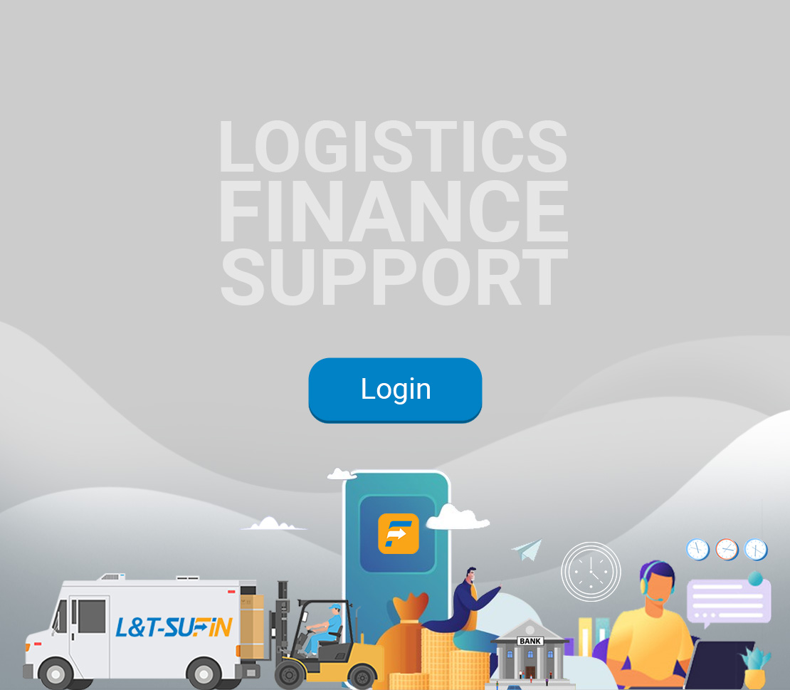

Introduction to L&T-SuFin…
L&T-SuFin is an integrated B2B marketplace for buying and selling of industrial and construction products
$
1

Slide 2










Critical role of MSMEs in the B2B Supply Chain Ecosystem
Financing
IT / ITES
Contract/ Legal support
Government
Government
Payments
Large corp.
Large corp.
Mid corp.
BUYER
SELLER
Mid corp.
MSME
MSME
Goods & Services
Manufacturing /
Operations
Contract Mfg
Services
Ancillaries
Logistics
2
Notes:
Quickly drawing attention on the L&T-SuFin focus on the SME segment.

Slide 3
Bridging the Need-gap for MSMEs in the ecosystem
1
2
3
Market Access for Sellers
Price & Product Discovery
Quality & Reliability of Sellers
PAIN
POINTS
PHYSICAL MARKET BEHAVIOUR
Dealing with limited customers in known network
Dealing with known Sellers
Dealing with known Sellers network
Lack of visibility
Access to channels
Payment Risks
Diversifying vendor-base
Price & product discovery thru digital means
Limited Seller base due to lack of Trust
NEED-GAP IN OFFLINE MARKET
Digital Channels
Pan-India visibility
Trusted & verified buyers
RFQ
Competitive price
Detailed specifications
Verified & trusted Seals to Buyers to ensure confidence
SUFIN SOLUTION
3

Slide 4
Bridging the Need-gap for MSMEs in the ecosystem
4
5
6
Immediate payment by Buyers
Discovering Logistics Partners
Working Capital
PAIN
POINTS
PHYSICAL MARKET BEHAVIOUR
Only to known Sellers or on receipt of goods from unknown sellers
Dealing with limited logistics partners.
Long haul a major concern
Unsecured Credit cost loaded in prices.
Unsecured loans are costly.
Lack of Trust on Quality or Quantity of unknown sellers
Existing rate contracts. No discovery of prices
Absence of Transaction based financing
Cost of borrowing
NEED-GAP IN OFFLINE MARKET
Payment in Nodal account and post confirmation from Buyer, its released
Multiple logistics partners with customized quote
Multiple Banking & NBFC offering OD, Invoice discounting, Channel
SUFIN SOLUTION
4

Slide 5
INTEGRATED SOLUTION
PRODUCT & PRICE DISCOVERY
TRANSACTION
LOGISTICS
Multiple Partners
FINANCING
Low to High volume orders
Immediate & Credit Payment
Wider reach
MARKETPLACE for the Industrial, Construction, and Engineering Goods, where
Seller Diversity is ensured | Seller Quality and Trust is ensured | Liquidity is ensured for trading on credit terms through Unsecured Working Capital facility | Order fulfilment through Logistic services
5

Slide 6

Diverse Spectrum of over 45+ Product Categories
Sub-Categories
Industrial Supplies and Consumables
Machinery, Tools & Mechanical Equipment
Automotive Spares & Parts
Bearings & Expansion Joints
Bolts, Nuts & Fasteners
Industrial Cleaning Chemicals
Lubricants & Oils
Safety Material
Welding Consumables
Building and Construction Materials
Hydraulics
Lab Equipment & Supplies
Material Handling Equipment
Measuring and Testing Instruments
Mechanical Equipment
Pneumatics & Pumps
Power Tools
Textile Machinery
Tools & Accessories
Construction Machinery
Cranes & Hoists
Adhesives & Sealants
Granite, Marble & Tiles
Masonry Blocks & Bricks
Paints & Related Material
Pipes & Fittings
Plumbing Tools & Accessories
Sanitary Ware & CP Fittings
Wood & Laminates
MS & GI wires
Electrical & Electronic Equipment & Supplies
Cable & Accessories
Conductors
Electrical Equipment & Supplies
Electronics, IT & Robotics
Insulators & Hardware Fittings
Luminaires & Other Electrical Items
Solar Equipment & Panels
Switchgear, Relay & Contactor
Packaging, Printing and Office supplies
2,30,000+ SKUs
Office Supplies
Packaging Material
6

Slide 7
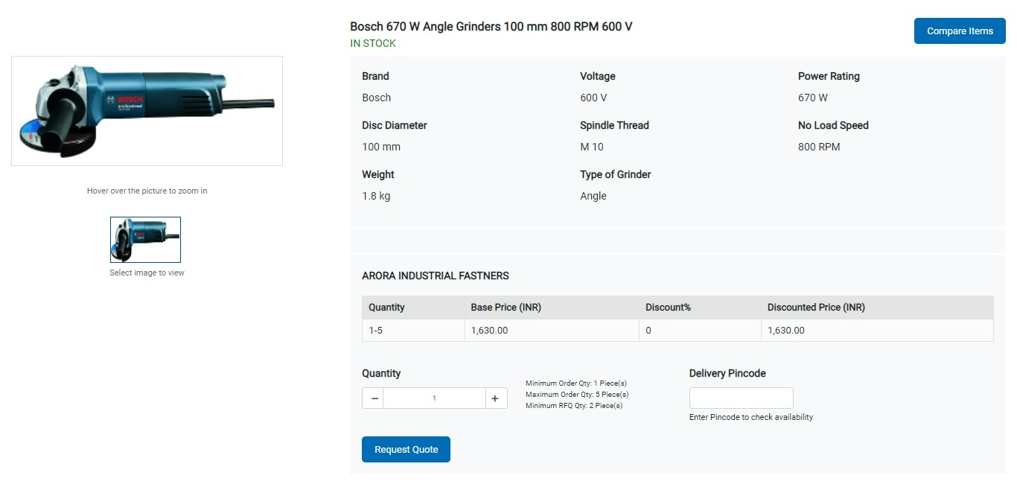
Brief Specifications of the Product is displayed
7

Slide 8
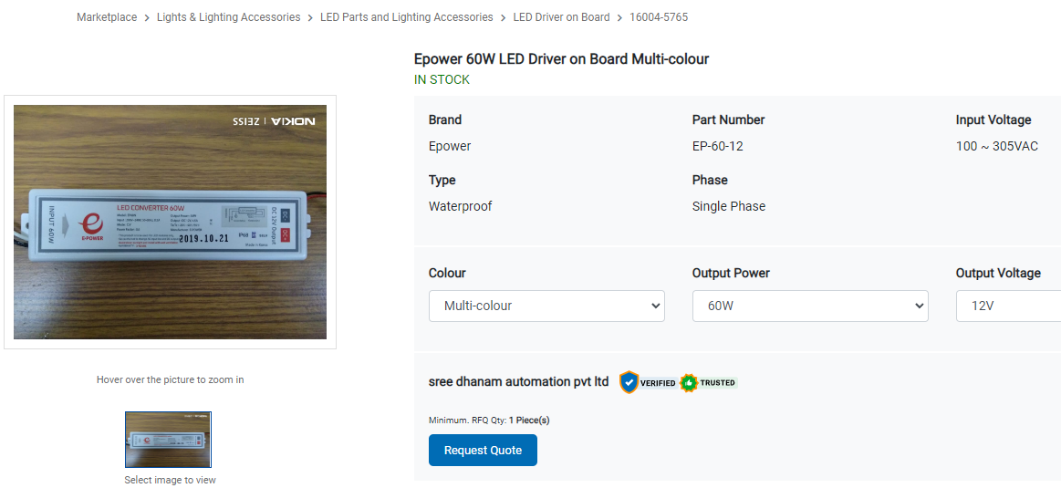
Brief Specifications of the Product is displayed
8

Slide 9


Pan India Presence
NORTH
6,000+ Sellers
70 Sales Staff
45+
Product Categories
WEST
10,000+ Sellers
90 Sales Staff
EAST
2,00,000+ SKUs
2,00,000+ SKUs
2,000+ Sellers
20 Sales Staff
SOUTH
23,000+ Sellers
5,000+ Sellers
40 Sales Staff
9

Slide 10





Key Value Proposition for the Users
Request for Quotation (RFQ)
RFQ for 200 product at a time on both credit & immediate payment terms
Working Capital Solution
Unsecured Financing solutions including Overdraft, Invoice discounting, Equipment Financing, Channel Financing by multiple Lenders | Reputed Banks and NBFCs as partners
Distributor Financing & Digital Channels for OEMs
Verification and Trust Seals to give confidence for dealing with unknown entities.
Logistics and Payment Gateway Services for order fulfilment and convenience
10

Slide 11

Value Proposition to Platform Users
Request for Quotation (RFQ)
Verification and Trust Seals
Unique Feature only available with SuFin
Discovery feature for better price realization.
Dealing with multiple unknown suppliers.
Multi product RFQ on both credit & immediate payment terms
Creates Trust and Confidence amongst the unknown entities transacting on the platform.
Helps Buyers to know the Qualitative Aspects of the Sellers.
Sellers are kept aware of the Creditworthiness of the Buyers.
Working Capital Solution
Logistic Services
Multiple Lenders on a single platform
Unsecured Financing enabled through a gamut of banking products
Competitive Interest rate in comparison to Market
Equipped to handle courier services, Part-truck, and Full-truck load.
Ensure on-time order delivery and convenience to the entities
Supply-chain Financing & Digital Channel
End to End Transaction Enablement
Creates a digital channel or digital front for the Mid-corporates.
Enables Channel Financing solutions for their dealers and vendors.
Provides Integrated seamless services from product search to delivery from a single platform and a payment settlement solution between the buying and the Selling entities enabling convenience for them.
11

Slide 12






L&T-SuFin Financing Solutions
WIDE RANGE OF
PRODUCT OFFERINGS
QUICK
APPROVALS
ATTRACTIVE
TERMS
SERVICE
QUALITY
Comprehensive financing options
Collateral free facilities available
Multiple lender options for right financing partner fit
Simplified online and paperless application
Quick processing for sanctions
Digital process for Transaction Financing
Competitive interest rates
Flexible tenor
Preferential offers from Leading Banks & NBFCs.
Dedicated Relationship Manager
Online Customer Support
Our Financing Products
WORKING CAPITAL FACILITIES
DISCOUNTING FACILITIES
TERM LOAN / LOAN
AGAINST PROPERTY
For your day-to-day working capital requirements
Avail instant funding for orders on our platform
Avail Loans for business expansion
CHANNEL FINANCE
BUSINESS LOANS
EQUIPMENT FINANCE
For Vendors/Dealers/Distributors in need of finance
Unsecured loans for your business needs
Get funds for purchasing Machinery/Equipment
12

Slide 13







End to End Delivery Solution
BENEFITS
COST EFFECTIVE LOGISTICS
FREE TRANSIT INSURANCE
EXPRESS COURIER SERVICE for Small shipments
Partnered with multiple logistics providers
Competitive pricing
Al based partner selection for best rates
Insurance coverage up to ₹5 crore
No premium charges
All platform products are covered
PART TRUCK LOAD SERVICE for Medium shipments
EXTENSIVE REACH
DELIVERING SERVICE QUALITY
High on-time performance
Easy tracking of shipment
Customer support during business hours
PAN India service
Delivery across 21000+ pin codes
Major industrial clusters covered
FULL TRUCK-LOAD SERVICE for Large shipments
13

Slide 14
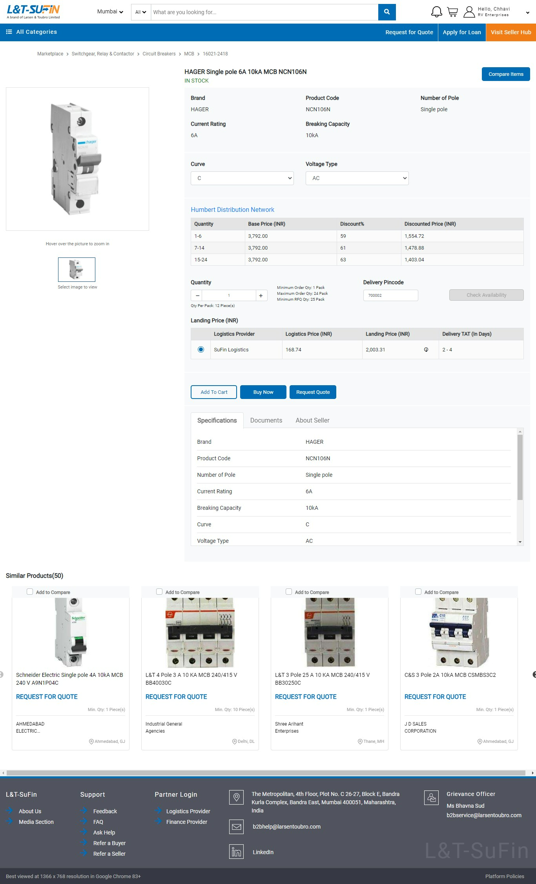
Do Quick Purchase
14

Slide 15
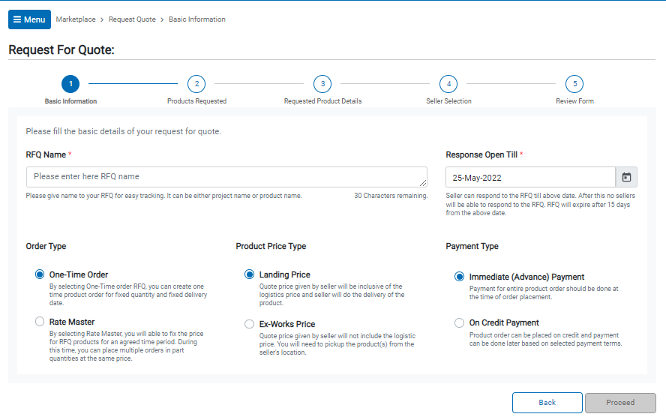
For Bulk Purchase use our RFQ feature
15

Slide 16

THANK YOU
REACH US AT:
Mobile: +91 8291211421
Email ID: b2bhelp@larsentoubro.com
www.Lntsufin.com
16

